Slide 1
Designing Known-Item and Fact-Finding Search Tasks for Studies of Interactive Information Retrieval
Barbara M. Wildemuth
University of North Carolina (USA)
Luanne Freund
University of British Columbia (Canada)
Elaine G. Toms
University of Sheffield (UK)

Slide 2
Search Tasks
As subtasks of information seeking tasks
Which are subtasks of work tasks
Work task
Information seeking task
Information seeking task
IRT
IRT
Figure adapted from Byström & Hansen, 2005, Fig. 1

Slide 3
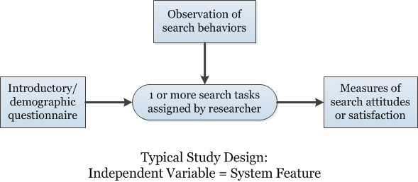
Context: Assigning Tasks in Interactive IR Experiments

Slide 4
Effect of Task on Search Behaviors
Task type
Exploratory tasks
“A type of information seeking and a type of sense-making focused on the gathering and use of information to foster intellectual development” (White & Roth, 2009, p38)
Discussed in Wildemuth & Freund (2012)
Fact-finding tasks
Known-item tasks

Slide 5
Method
Systematic review of literature
480 references in the database
95 empirical and conceptual papers on known-item or fact-finding tasks
Called: known-item search, author/title search, simple search, specific/well-defined search, closed search, navigational search, informational search, lookup search, fact-finding/fact-based/factual search

Slide 6
Fact-Finding Tasks
“The goal [of the search task] was to find one specific answer to a simple question.” (Aula & Nordhausen, 2006, p.1682)
“Seeking information with the goal of finding specific factual information to answer a well-specified question or fill a known gap in knowledge.” (Freund & Berzowska, 2010, p.3)

Slide 7
Examples of Fact-Finding Tasks
When? How long?
How long do alligators live in the wild, and how long in captivity? (Bilal & Kirby, 2002)
Who?
What is the name of the Chair of the Department of Psychology [at the University of Michigan]? (Gwizdka & Spence, 2006)
Where?
Name four places to get a car inspection for a normal passenger car in Salem, NC. (Feild, Allan, & Jones, 2010)
What?
Kari Kärkkäinen is a Member of Parliament. To which party does he belong? (Aula, 2003)
How much? How many?
According to the Bible, how old was Methuselah when he died? (White & Iivonen, 2001)

Slide 8
Fact-finding Tasks as Simulated Work Tasks*
Example:
As a volunteer at a local museum, you have been asked to help prepare a public school workshop on Canadian weather disasters. You remem­ber that Hurricane Juan hit Nova Scotia a few years ago, and you decide to prepare an information sheet for the students. Search for factual information about Hurricane Juan including where and when it hit and how much damage it caused. (Freund & Berzowska, 2010)
*Borlund, 2003

Slide 9
Known-Item Tasks
“Searches for a particular item (book or other document) which is known to exist (although not necessarily in the library where the search takes place) and on which the searcher has such information as author and title” (Tagliacozzo & Kochen, 1970, p.364)

Slide 10
Example Known-Item Task
You are working your way through the Harry Potter books and are ready to read the next one on your list, titled “Harry Potter and the Goblet of Fire”. (Kules & Capra, 2008)

Slide 11
Navigational Tasks
Example: Find the symptom checker webpage of WebMD. (Dumais, Buscher, & Cutrell, 2010)
Different than a known-item task?

Slide 12
What makes for a “good” search task?
Make the task description as authentic and plausible as possible
Use simulated work task scenarios
Document the attributes of the search task
Domain of interest
Number and specificity of information elements in the task and information items to be found
Finding versus re-finding

Slide 13
Open questions
Which attributes of known-item and fact-finding tasks have the strongest influence on search behaviors?
What other types of tasks should be included in interactive IR experiments?
Is it possible to re-use search tasks across studies? Is it desirable?

Slide 14
Questions? Suggestions for next steps?
Contact information:
Barbara Wildemuth
wildemuth@unc.edu
Luanne Freund
luanne.freund@ubc.ca
Elaine Toms
e.toms@sheffield.ac.uk

